Slide 1
SHWN_HNIF (HENIFF TRANSFORMATION SYSTEMS, LLC.)
Always key the following, visible in the invoice separator sheet:
Batch ID (68) BAT ID (69) Value/No
Client Code (68) CL CODE (69) SHWN
Scac Code (68) SCAC CODE (69) HNIF

Slide 2
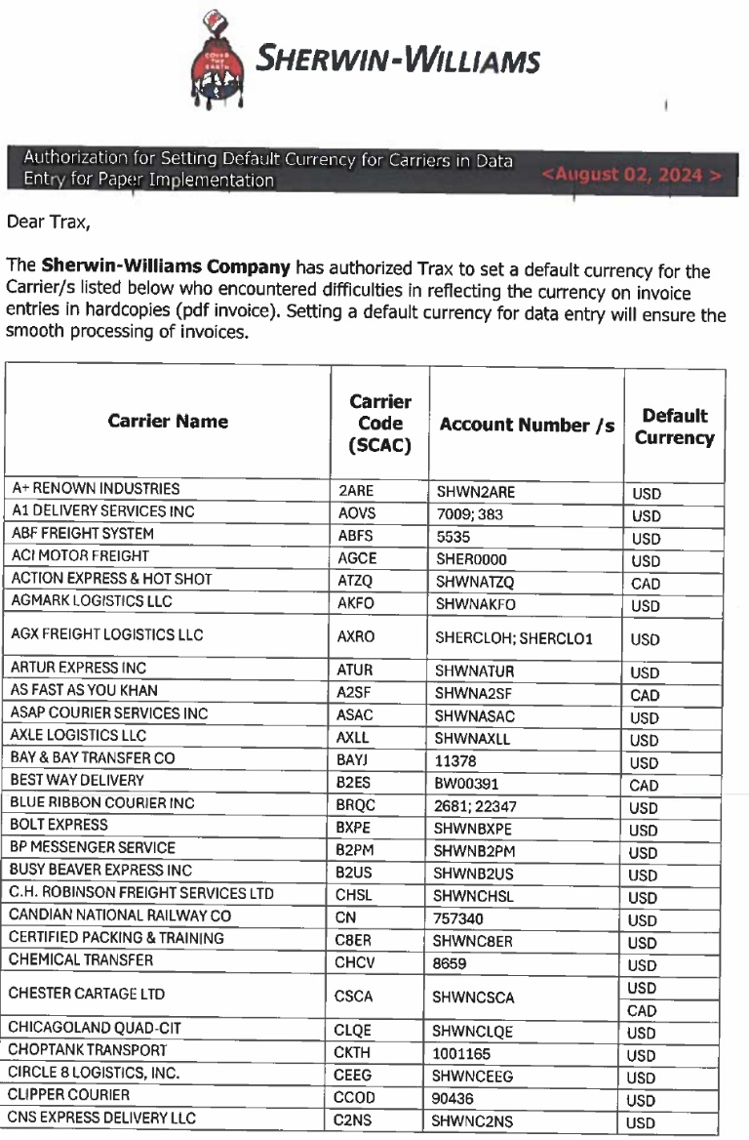
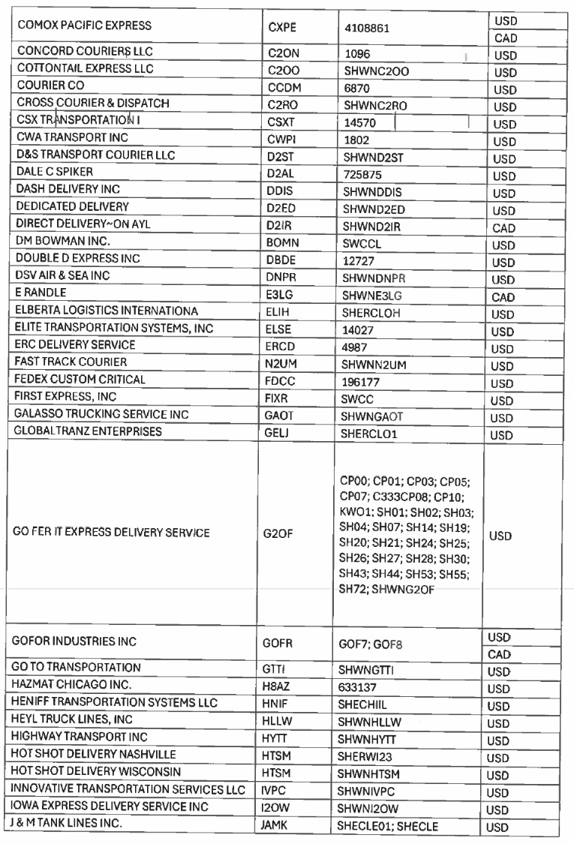
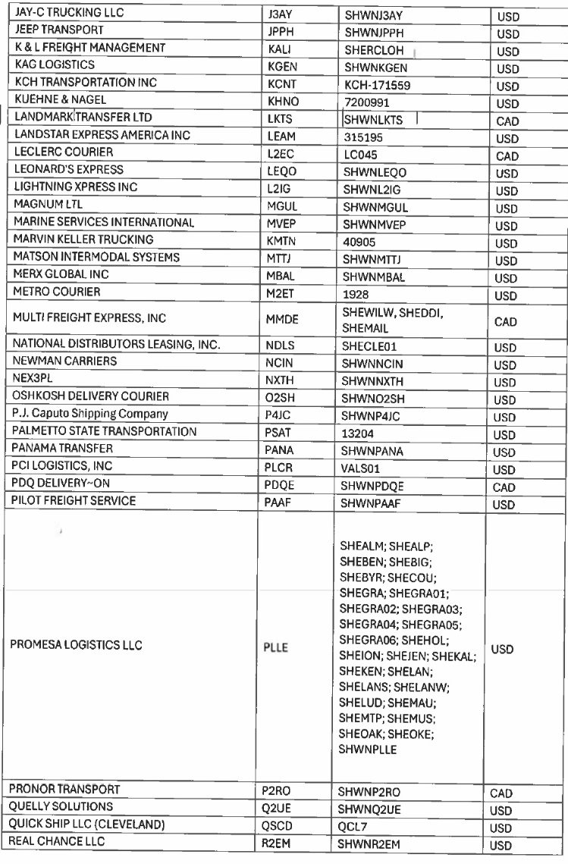
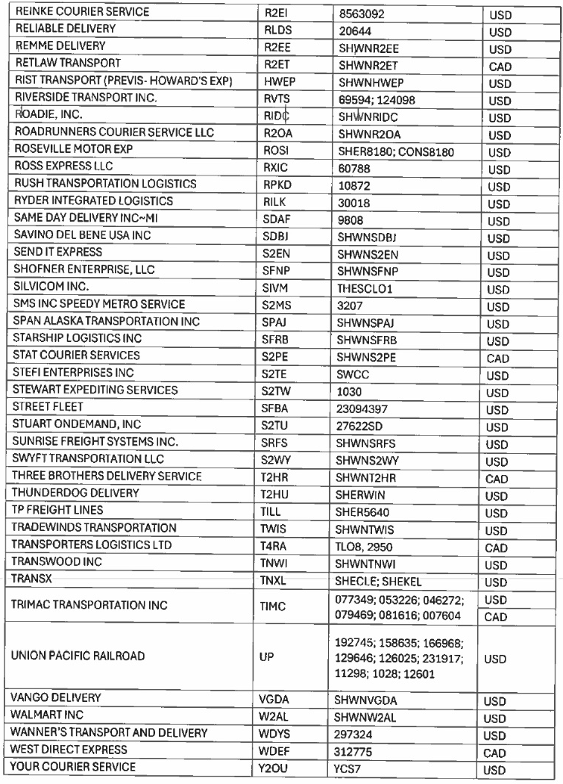
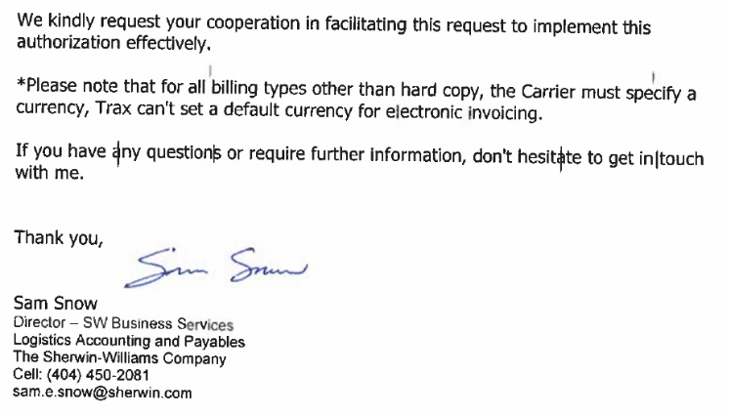

Slide 3
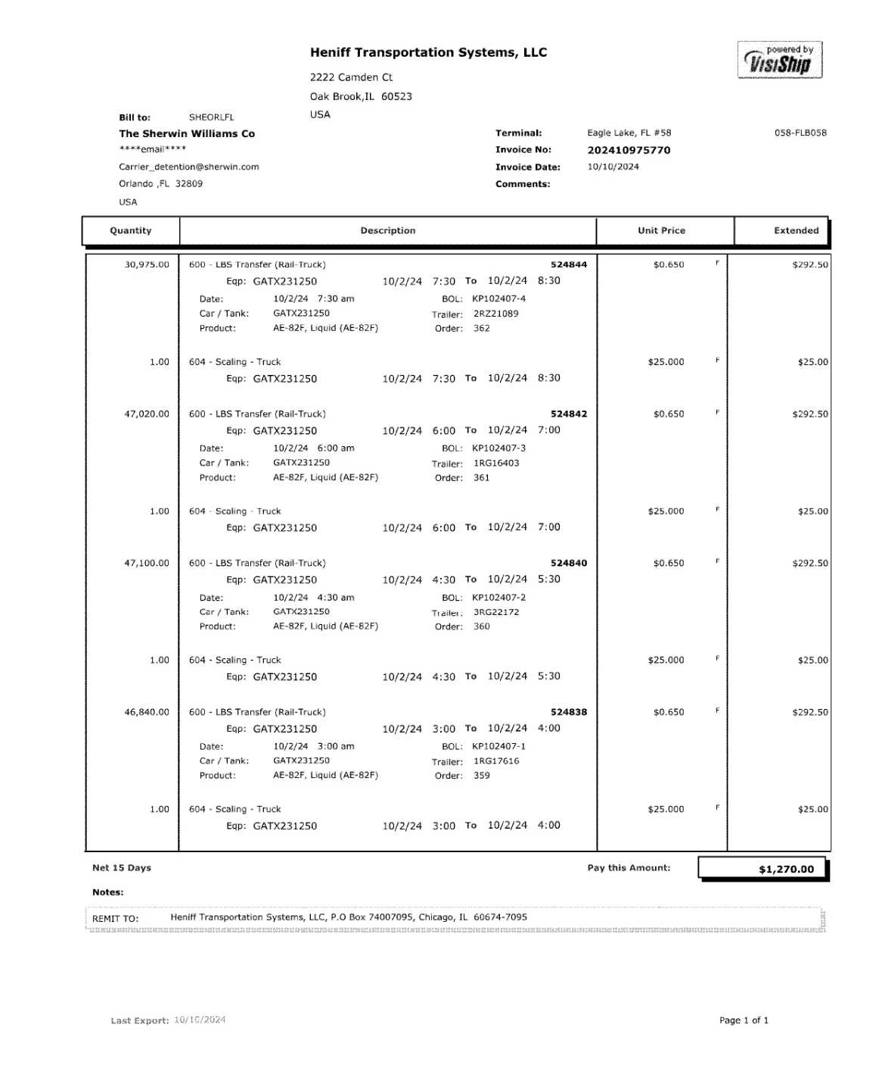
03
02
10
72
68a
62
61
85
01 REMIT TO
02 BILL TO
03 INV KEY
10 DATE
13 FB KEY
42/43 ACUAL WT/ FNCL WT
44/45 ACTUAL WT UOM/ FNCL WT UOM
61 PICKUP
62 DELIVERED
64 TRAILER NO
72 LINE ITEM DESC
74 LINE ITEM QTY
85 LINE ITEM AMT
90 PROD DESC
68a BOL
68b ORD
08/14 INV AMT/FB AMT
74
42/43
44/45
13
64
90
68b
08
01
NOTE:
Please use “USD” as 09 CURRENCY Authorization letter for using default currency is in slide 2.

Slide 4
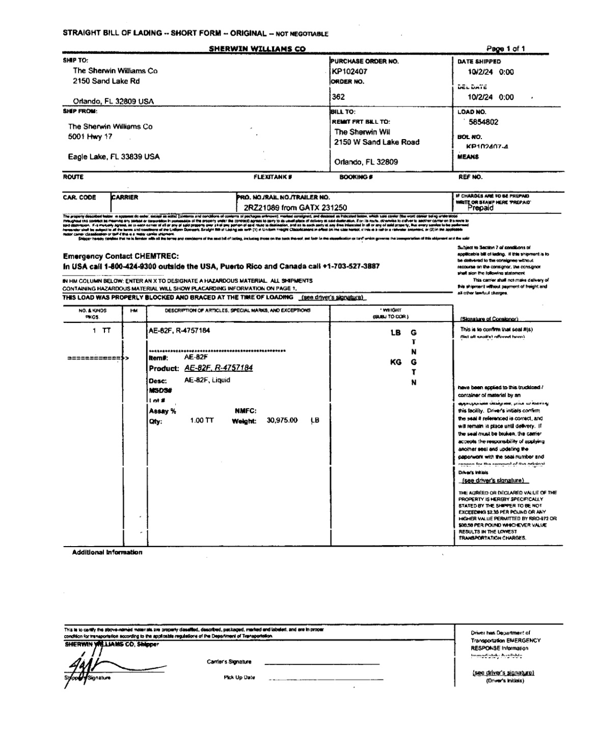
61
28
62
31
36
28 SHIPPER BOL
31 CONSIGNEE BOL
36 FRGHT TERM
61 PICK UP
62 DELIVERED

Slide 5
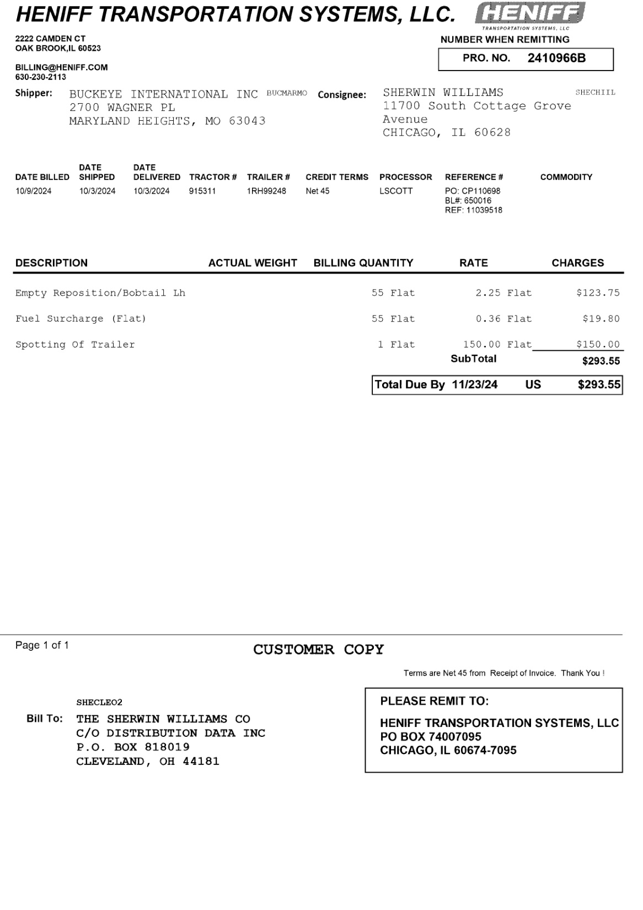
03
30
01 REMIT TO
02 BILL TO
03 INV KEY
05 ACCT NO
09 CURR
10 DATE
11 DUE
27 SHIPPER INV
30 CONSIGNEE INV
61 PICKUP
62 DELIVERED
64 TRAILER NO
72 LINE ITEM DESC
74 LINE ITEM QTY
75 LINE ITEM RARE
77 LINE ITEM RTUNIT
85 LINE ITEM AMT
68a TRAILER NO
68b BOL
68c PO
68d REF
68e TRACTOR NO
08/14 INV AMT/FB AMT
27
61
62
68a
68c
10
68b
68d
68e
75
77
72
74
85
08/14
11
09
05
NOTE:
Use service code LB for all of the invoices under SHWN_HNIF.
02
01

Slide 6
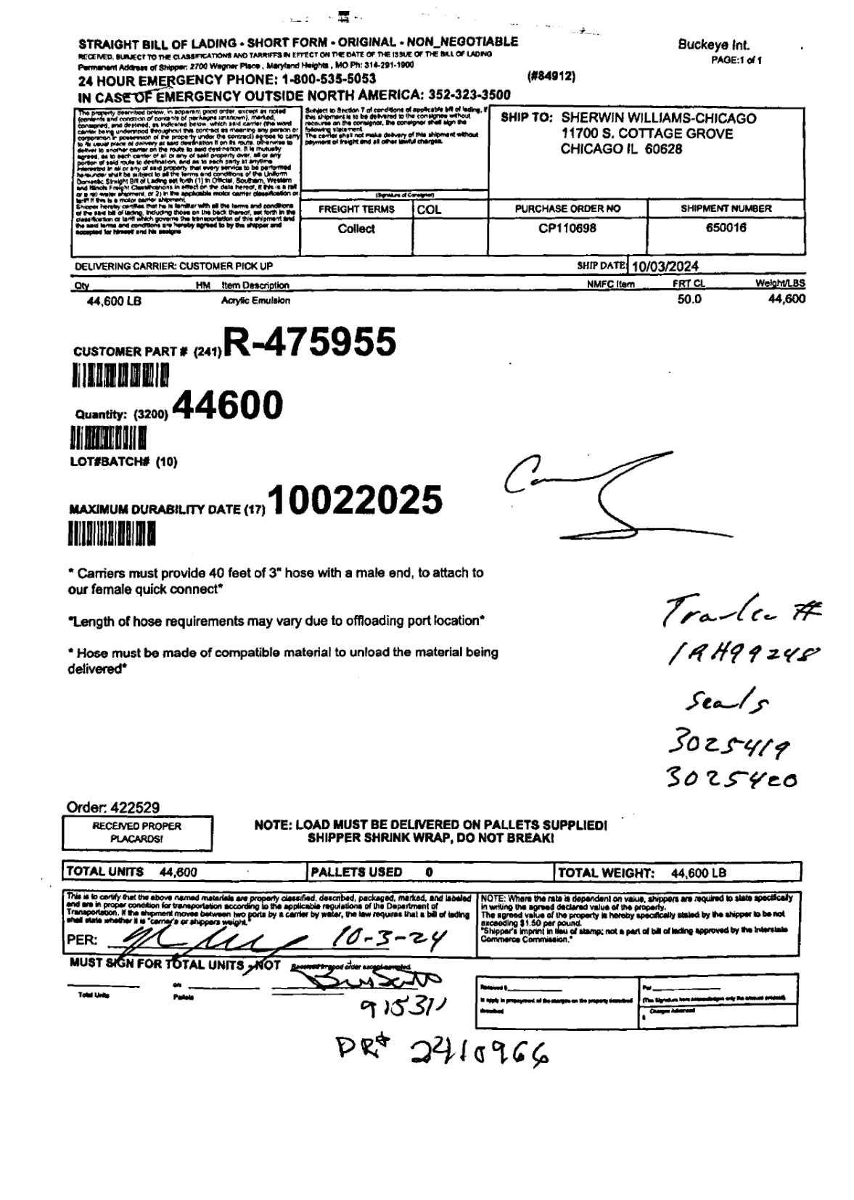
31
36
68b
68a
90
61
68a SHIPMENT ID
68b PO
68c TRAILER NO
68d SEAL NO
68e ORD
95 PCS CNT
96/97 GROSS/NET WT
98 WT UOM
31 CONSIGNEE BOL
36 FREIGHT TERM
90 PROD DESC
61 PICK UP
95
68c
68d
68e
96/97
98

Slide 7
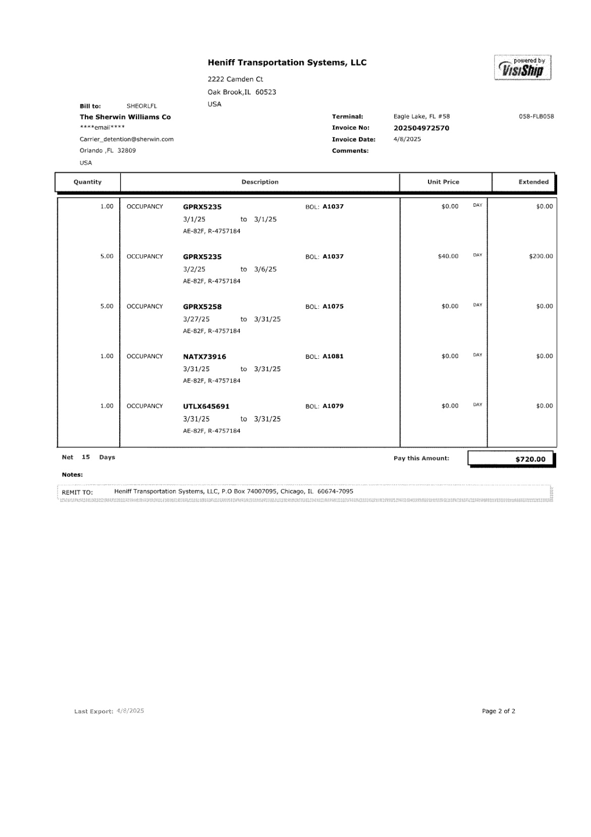
03
02
10
74
13
KEY AS FRGHT
01 REMIT TO
02 BILL TO
03 INV KEY
10 DATE
13 FB KEY
61 PICKUP
62 DELIVERED
74 LINE ITEM QTY
85 LINE ITEM AMOUNT
68a BOL
08 INV AMT
14 FB AMT
61
62
68a
85/14
75
01
08

Slide 8
6
For Verification Table
 | NAME | DATE
DI-64883 | CIDJANE J. LOCAYLOCAY | 10/22/2024
DI-67268 – Added new invoice format (slide 5&6) | CIDJANE J. LOCAYLOCAY | 1/17/2025
DI-69667 – Added new invoice format (slide 7) | PHILLIP L. RAMISCAL | 4/11/2025
DI-76153- Added note on slide 5 | NOVA VIRTUCIO SONCADOS | 11/25/2025

